Slide 1
Explanatory analytics
Data wrangling for multiple regression
Specifying a model
Visualizing the explanation
Checking the model

Slide 2
Ex2: Class walk through (cont)
Based on the Manheim case
http://aisel.aisnet.org/cais/vol1/iss1/20/
Use Manheim car sales data
manheim.csv
Visualize price, miles, and model
Viz - scatter

Slide 3
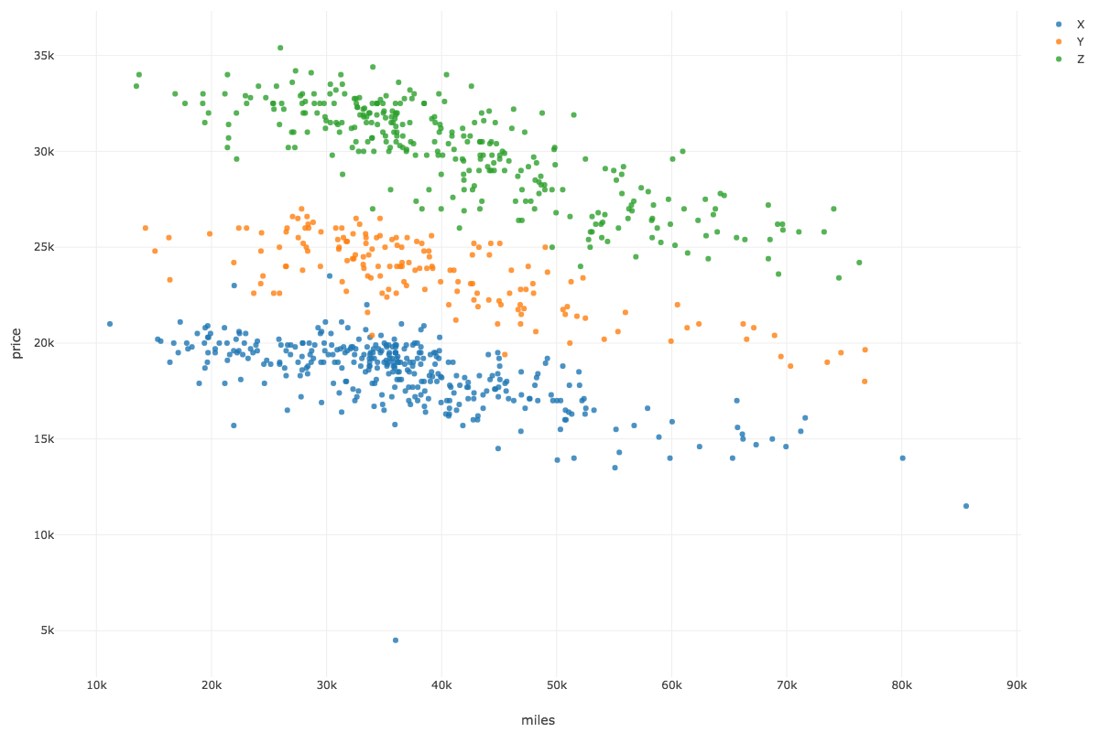

Slide 4
Ex2: Class walk through
Visualize price, miles, and sale
Viz - scatter

Slide 5
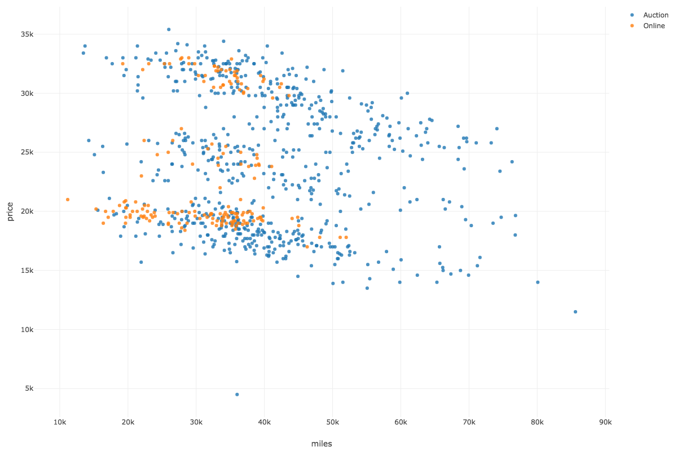

Slide 6
Ex2: Class walk through
Create a model of the form
price = f(miles, model, sale)
Build model – Build GLM
Explain the difference in the prices of cars
Term | Estimate | P-value
(Intercept) | 22887.74 | 0.00
miles | -0.13 | 0.00
modelZ | 12240.00 | 0.00
modelY | 5616.91 | 0.00
saleOnline | 591.75 | 0.00

Slide 7
Ex2: Class walk through
Create a model of the form
price = f(miles, model, sale)
Build model – Build GLM
Explain the difference in the prices of cars
Graph residuals
price vs residuals
Viz – Scatter
Are there any problems?

Slide 8
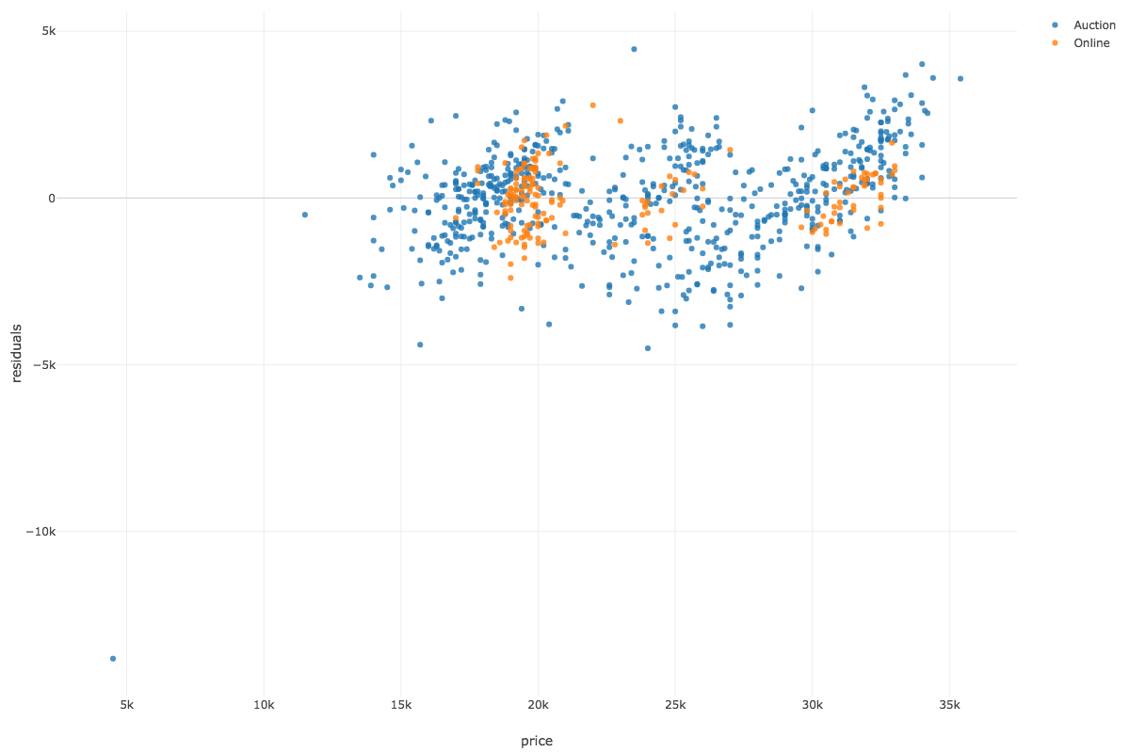

Slide 9
Predicting or setting price
Price = 22888 + -.13*miles + modelType + saleType

Slide 10
Class assignment #2

Slide 11
New York City bike counts
New York City Department of Transportation (DOT) conducts regular bike counts on the East River bridges. DOT installed automated counters, which provide continuous 24 hour data every day of the year. The dataset also contains temperature and precipitation data.
NYCBiking.xlsx

Slide 12
New York City bike counts
Prepare the file for analysis
Report trips into and out of Manhattan by bridge and day of the week? (Pivot table)
Develop a linear regression model to predict trips each day of the week for each bridge. Variable determination should result depicted in residual plot in the following slides.
Do you have any concerns with the model?

Slide 13
Submission – Publish your tables and charts on Exploratory. Screenshot the images and upload 1 Word file with the names of the 2 people who worked on it. Turn in the following
Trips Analysis - Bridge by Day of Week
Linear Regression analysis and interpretation (sig + estimate)
Residuals Analysis (graph)

Slide 14
Trips analysis
Bridge | 1 | 2 | 3 | 4 | 5 | 6 | 7
Brooklyn | 74,976 | 98,293 | 96,882 | 105,796 | 99,524 | 90,949 | 82,150
Manhattan | 119,802 | 167,072 | 172,546 | 182,564 | 167,546 | 148,612 | 123,036
Queensboro | 95,959 | 137,135 | 142,701 | 156,830 | 146,057 | 131,761 | 109,912
Williamsburg | 134,471 | 198,705 | 211,339 | 227,478 | 210,312 | 186,200 | 149,922

Slide 15
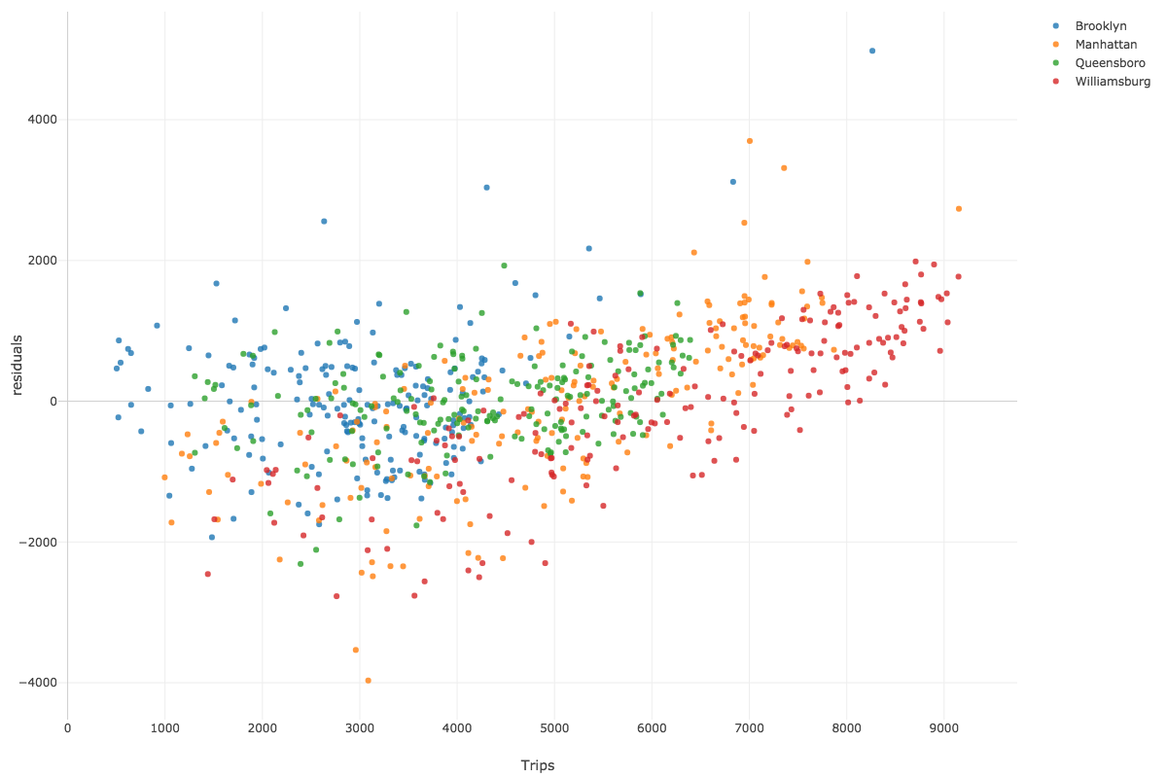
Residuals analysis

